Slide 1

Conditioned Factor Predictability from Co-Trading Synchronization
William Yao
UCLA Math 279 Final Project

Slide 2
Core Question
ETF Predictability - Do ETF returns predict stock returns in the cross section?
Synchronization Effect - Does predictability depend on market-wide co-trading synchronization?
Timing & Sign - Does the effect appear as continuation or reversal, overnight or intraday?
Core benchmark:
Stock close-to-close returns on ETF close-to-close predictors, with synchronization built from the full stock universe.

Slide 3
Methodology

Slide 4
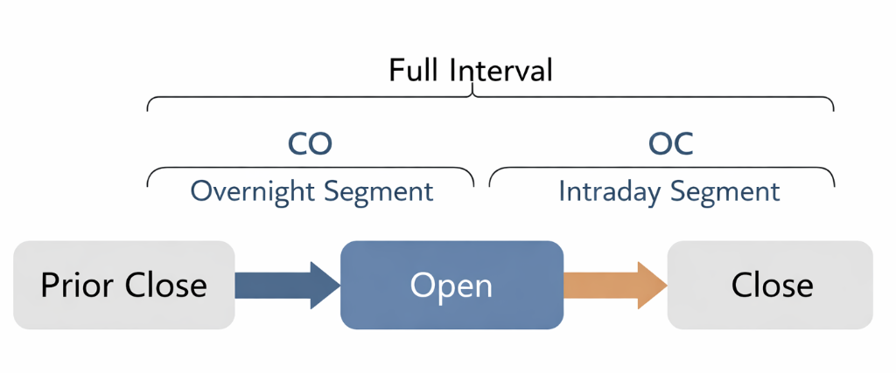
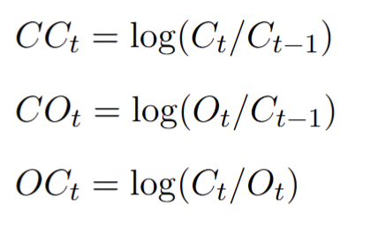
Data and Return Construction
Sample Period
Rebuilt from 2000–2023 using adjusted prices.
Return Types
Close-to-close:
Overnight:
Intraday:

Slide 5
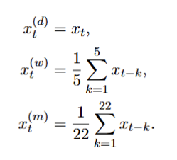
HAR Aggregation
These transformed series are built separately for stock returns and ETF returns, and separately for close-to-close, close-to-open, and open-to-close returns where relevant.

Slide 6
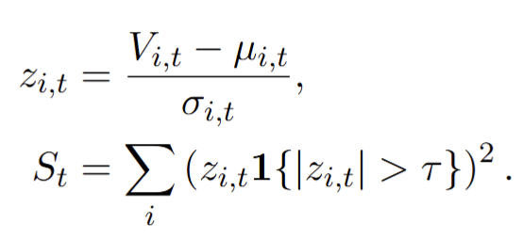
Synchronization Measure
Standardize stock-level abnormal volume
Keep only unusually large shocks.
Aggregate squared shocks across stocks
Define high synchronization as the top 20% of days.

Slide 7
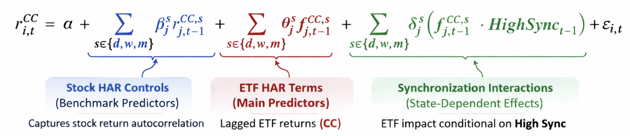
Benchmark Design
Target: stock close-to-close return
Predictors: stock HAR controls plus ETF close-to-close HAR terms
Key interaction: ETF predictors times market-wide high synchronization
Emphasis on signs and relative magnitudes rather than naive pooled t-statistics.

Slide 8
Results

Slide 9
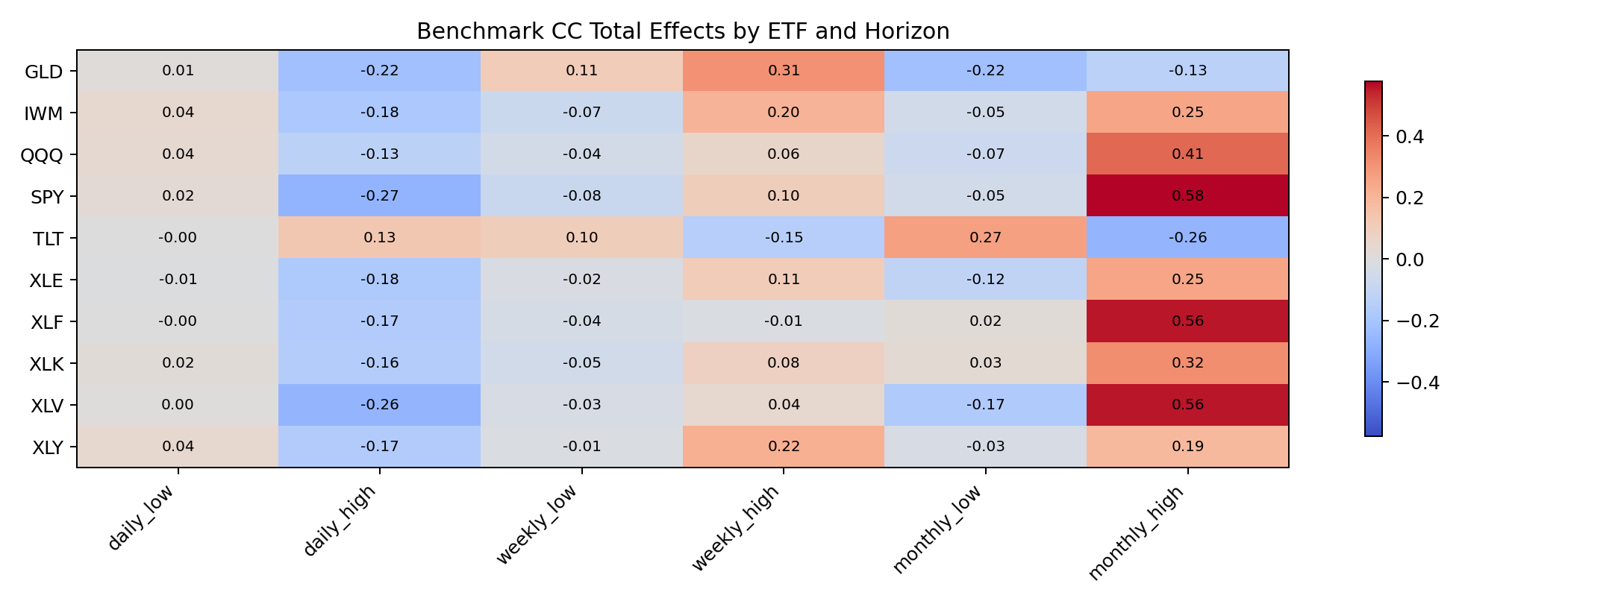
Main Benchmark Result
Low synchronization: weak daily continuation
High synchronization: strong daily reversal for equity ETFs
Weekly and monthly effects become more positive in high synchronization
TLT behaves differently from the equity ETFs.

Slide 10
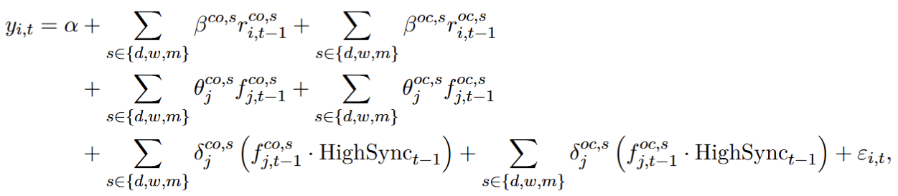
Extension 1 – Timing Decomposition

Slide 11
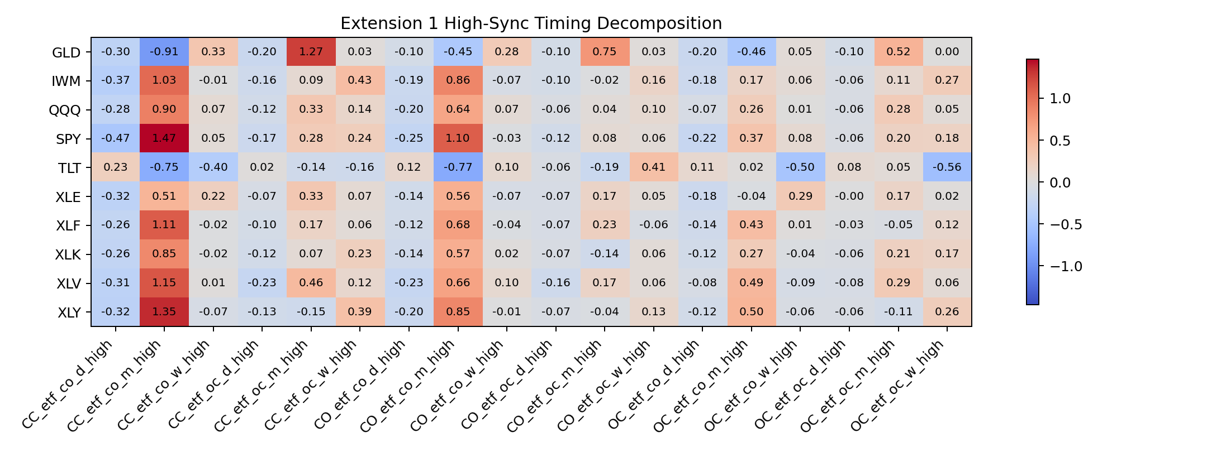
Extension 1 – Timing Decomposition

Slide 12
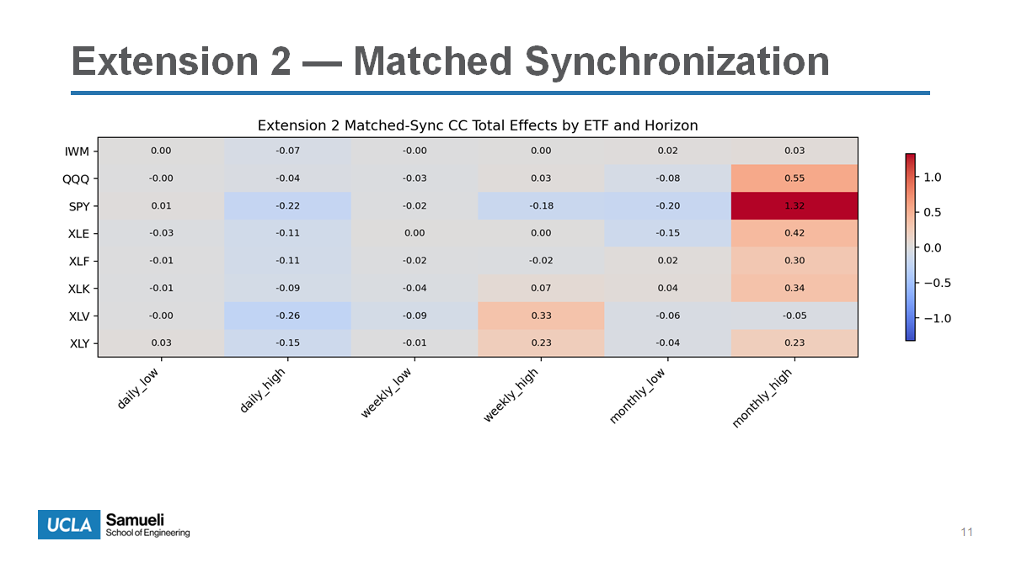
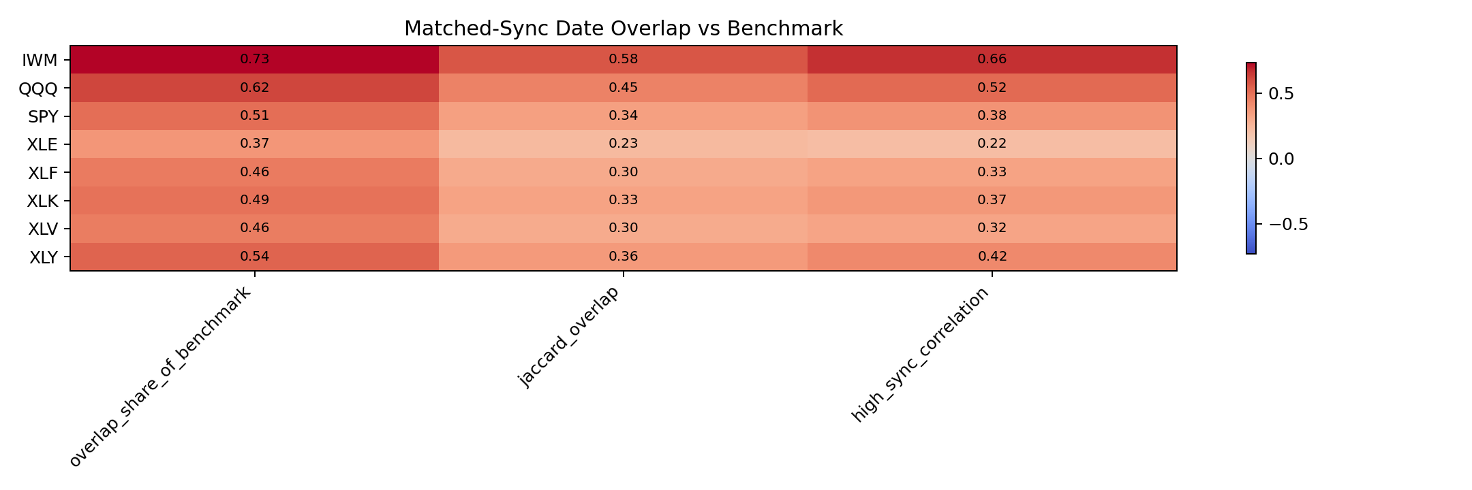
Extension 1 – Timing Decomposition

Slide 13
Extension 1 – Timing Decomposition

Slide 14
Out-of-Sample Forecasting
ETF | HAR_IC | Best_Model | Best_IC | IC_Gain_vs_HAR | Interpretation
XLY | 0.002747 | sync_etf_har | 0.004541 | 0.001794 | Improves ranking
IWM | 0.002349 | sync_etf_har | 0.003763 | 0.001413 | Improves ranking
XLE | 0.002747 | matched_sync_etf_har | 0.003856 | 0.001109 | Improves ranking
XLF | 0.002747 | matched_sync_etf_har | 0.003504 | 0.000758 | Improves ranking
SPY | 0.002747 | sync_etf_har | 0.00345 | 0.000703 | Improves ranking
TLT | 0.001222 | sync_etf_har | 0.001814 | 0.000593 | Improves ranking
GLD | 0.003178 | etf_har | 0.00349 | 0.000312 | Improves ranking
XLV | 0.002747 | sync_etf_har | 0.003038 | 0.000292 | Improves ranking
QQQ | -0.00022 | har_only | -0.00022 | 0 | No OOS improvement
XLK | 0.002747 | har_only | 0.002747 | 0 | No OOS improvement
ETF-augmented models improve daily information coefficients for several major ETFs.
Gains are strongest for SPY and IWM
QQQ remains weaker out of sample.
No rmse improvement

Slide 15
Portfolio and Economic Significance
ETF | HAR_Gross_Sharpe | Best_Gross_Model | Best_Gross_Sharpe | Gross_Sharpe_Gain_vs_HAR | Best_Mean_Gross_Return | Best_Cum_Gross_Return | Interpretation
XLE | 0.013354 | sync_etf_har | 0.358866 | 0.345512 | 0.00031 | 1.635 | Gross improvement
XLF | 0.013354 | matched_sync_etf_har | 0.269985 | 0.256631 | 0.000252 | 1.329 | Gross improvement
SPY | 0.013354 | matched_sync_etf_har | 0.240203 | 0.226849 | 0.000228 | 1.202 | Gross improvement
IWM | -0.051 | sync_etf_har | 0.153886 | 0.20489 | 0.000148 | 0.782 | Gross improvement
XLY | 0.013354 | matched_sync_etf_har | 0.203537 | 0.190183 | 0.000199 | 1.05 | Gross improvement
XLV | 0.013354 | sync_etf_har | 0.131129 | 0.117774 | 0.000119 | 0.629 | Gross improvement
TLT | -0.19795 | sync_etf_har | -0.10113 | 0.09682 | -9.00E-05 | -0.476 | Gross improvement
GLD | -0.06418 | sync_etf_har | -0.00863 | 0.055557 | -8.00E-06 | -0.037 | Gross improvement
XLK | 0.013354 | matched_sync_etf_har | 0.03167 | 0.018316 | 3.10E-05 | 0.165 | Gross improvement
QQQ | -0.47403 | har_only | -0.47403 | 0 | -0.00043 | -1.578 | No gross improvement
Takeaway: the predictive signal appears economically meaningful before trading frictions are imposed.

Slide 16
Conclusion
ETF predictability is state-dependent
High synchronization flips short-horizon equity predictability from continuation to reversal
Timing decomposition shows distinct overnight and intraday channels
Matched synchronization is economically meaningful but does not replace the benchmark
Forecast and portfolio results show promise but also clear implementation frictions.

Slide 17

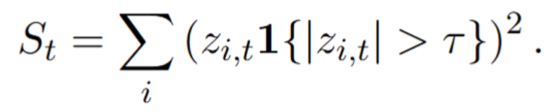
Future Research
Replace the scalar synchronization index with a pairwise co-trading matrix.
This would measure which stocks co-move in abnormal trading activity with each other, not just how much aggregate synchronization exists.
It could reveal sector clustering, market leadership, and whether ETF predictability depends on the structure of the network, not just the overall intensity.
Improve the portfolio design to reduce trading frictions.
Test slower rebalancing, signal smoothing, holding-period overlap, or threshold-based trading.
Current gross results are promising, but turnover is too high.
vs

Slide 18
References
Barberis, N., Shleifer, A., and Vishny, R. (1998). A model of investor sentiment. Journal of Financial Economics, 49(3):307–343.
Ben-David, I., Franzoni, F., and Moussawi, R. (2018). Do ETFs increase volatility? The Journal of Finance, 73(6):2471–2535.
Corsi, F. (2009). A simple approximate long-memory model of realized volatility. Journal of Financial Econometrics, 7(2):174–196.
Coval, J. and Stafford, E. (2007). Asset fire sales (and purchases) in equity markets. Journal of Financial Economics, 86(2):479–512.
De Long, J. B., Shleifer, A., Summers, L. H., and Waldmann, R. J. (1990). Noise trader risk in financial markets. Journal of Political Economy, 98(4):703–738.
Jegadeesh, N. and Titman, S. (1993). Returns to buying winners and selling losers: Implications for stock market efficiency. The Journal of Finance, 48(1):65–91.
Lo, A. W. and MacKinlay, A. C. (1990). When are contrarian profits due to stock market overreaction? The Review of Financial Studies, 3(2):175–205.

